Slide 1
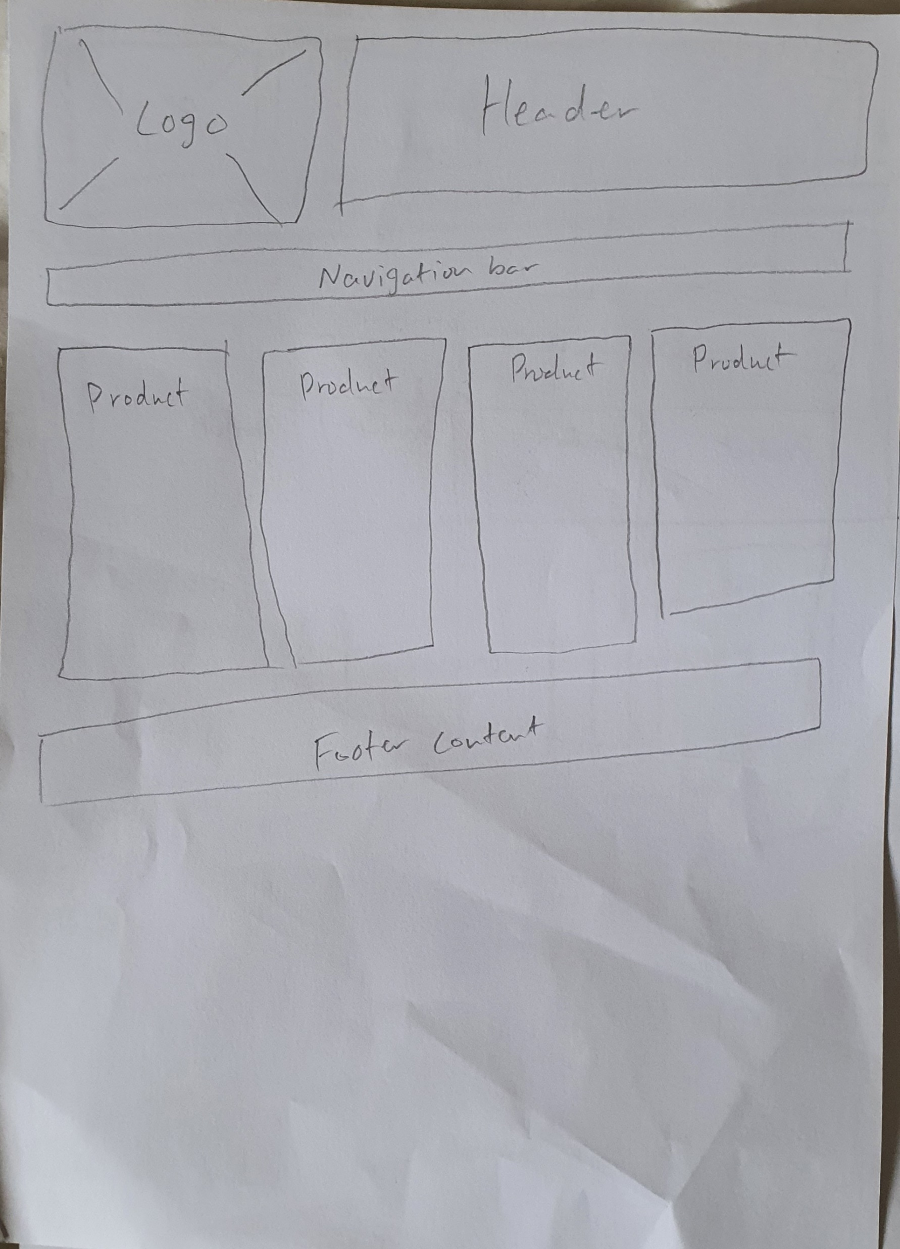
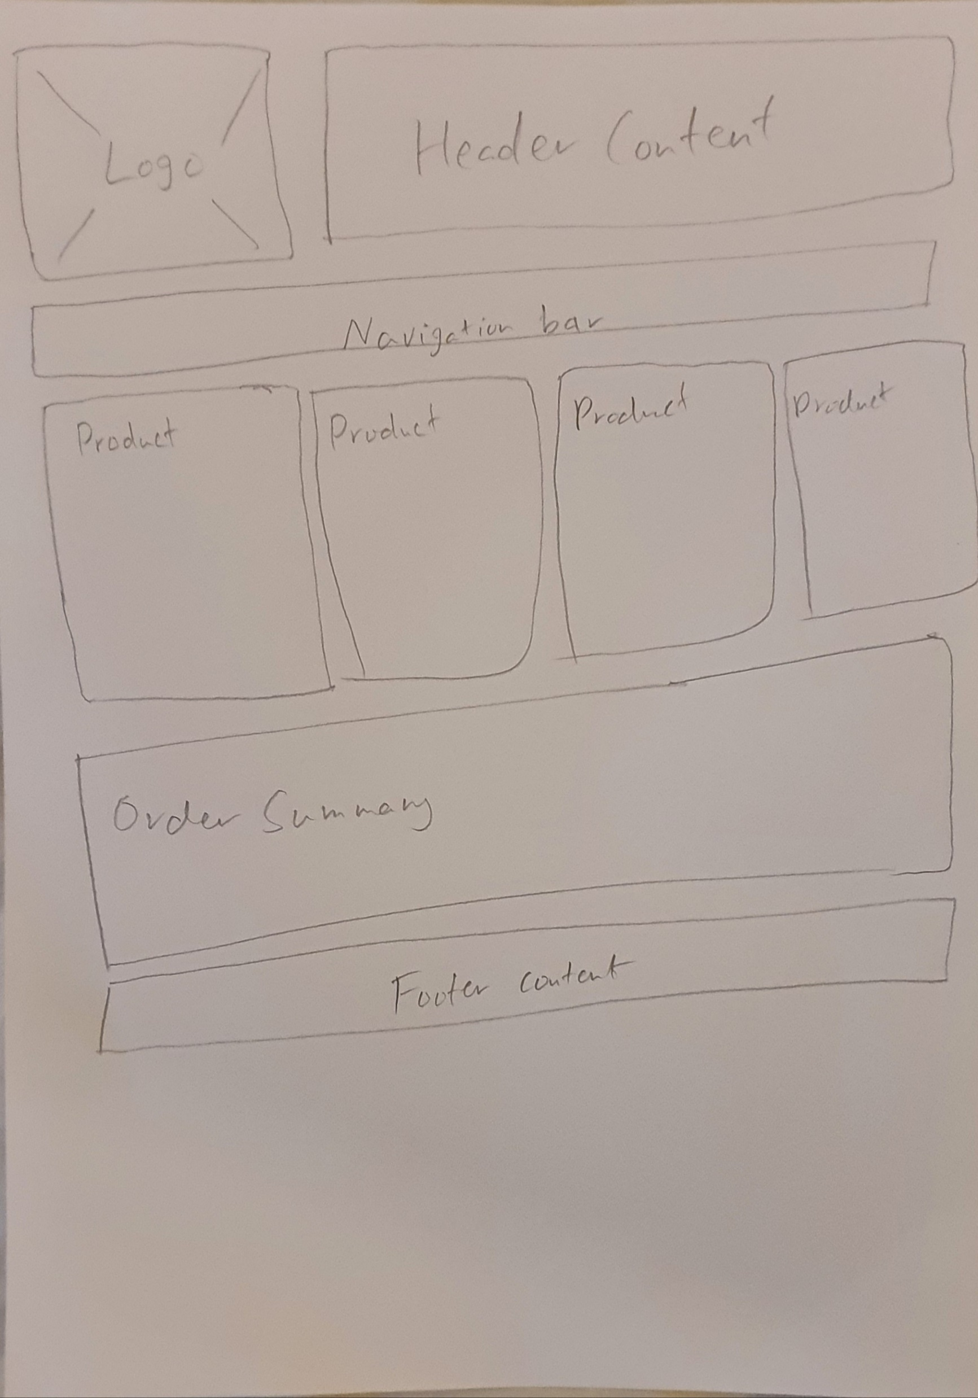

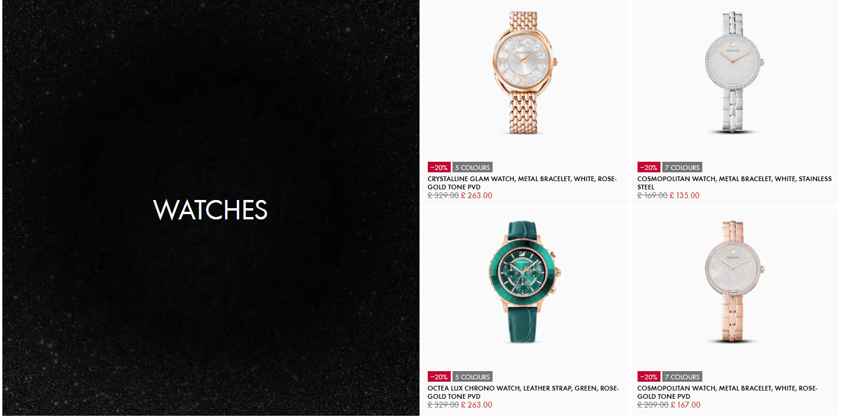
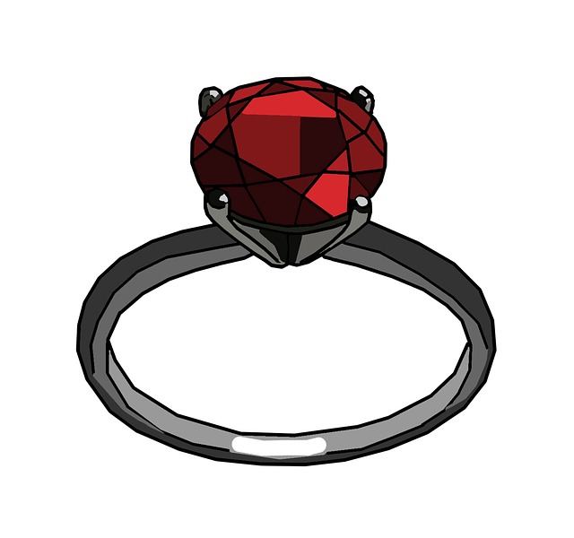
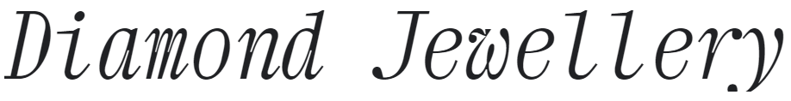
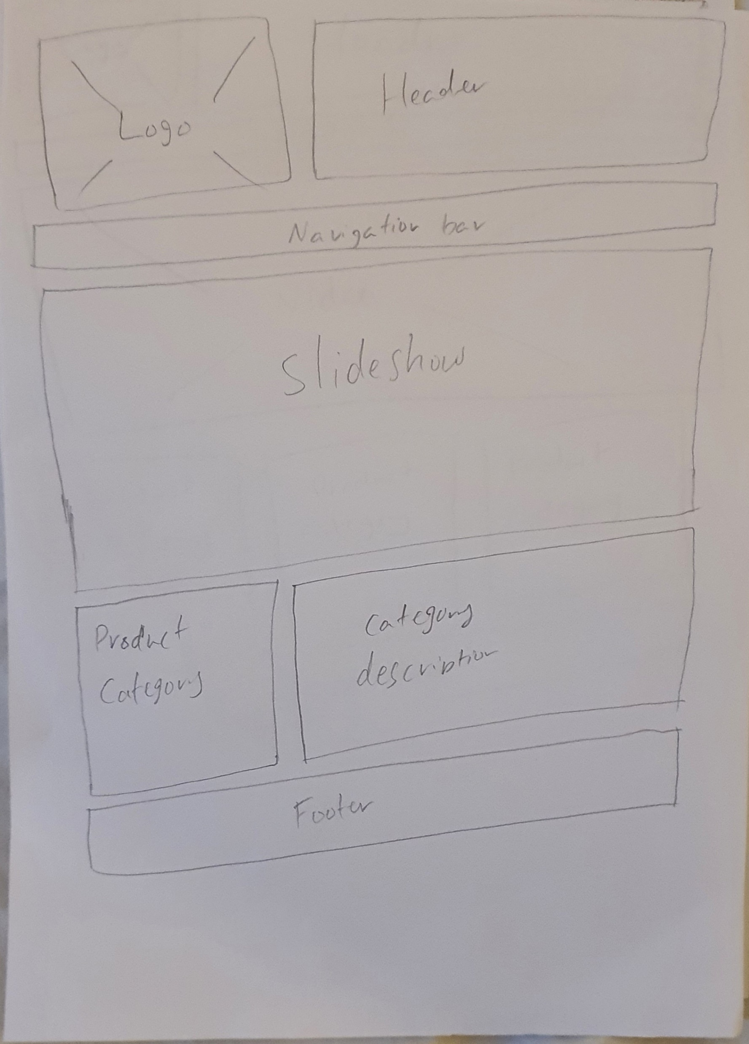
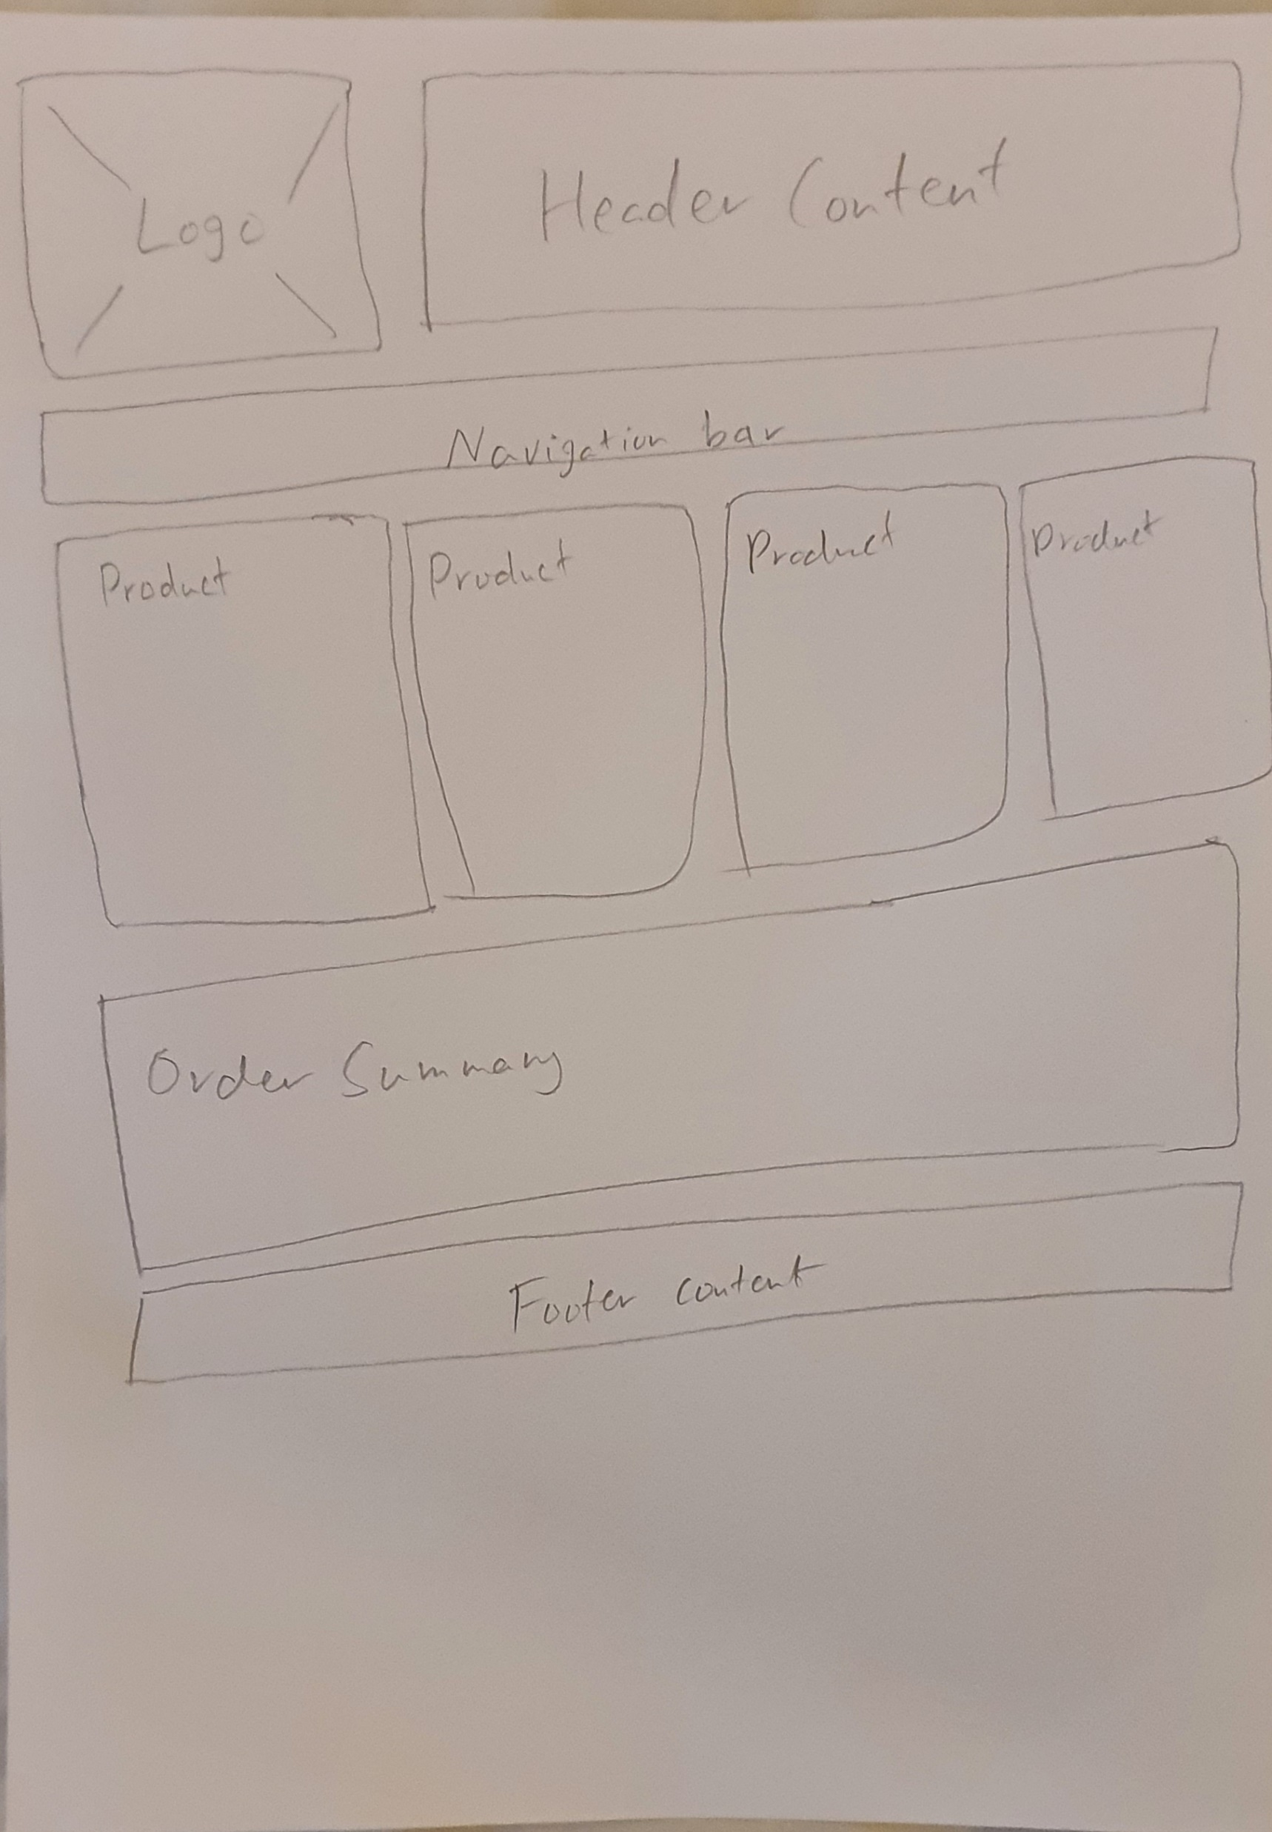
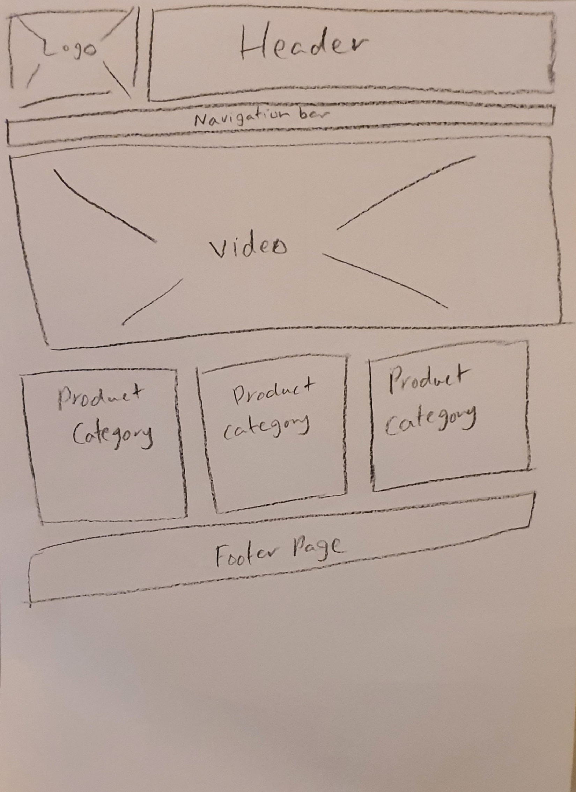
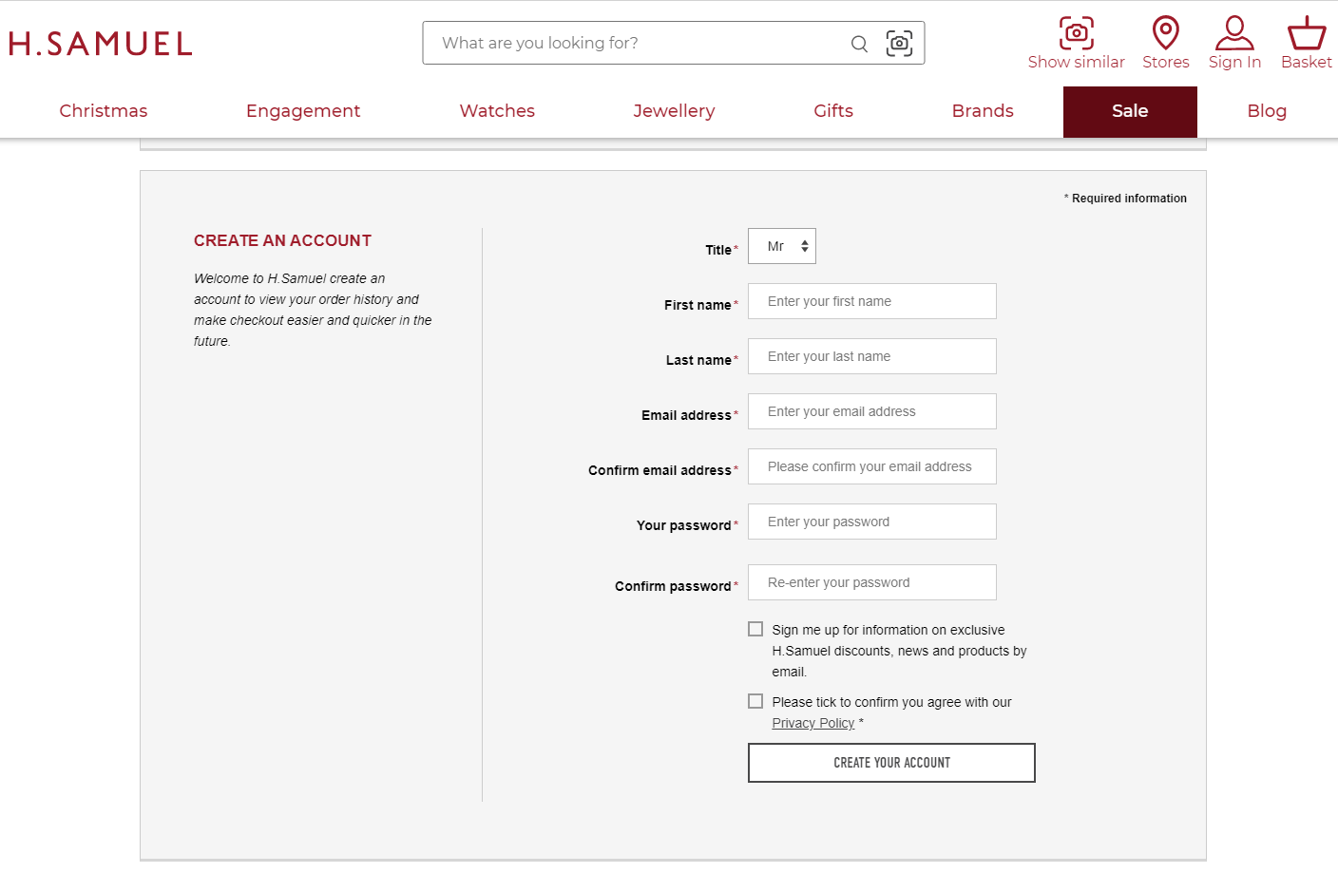
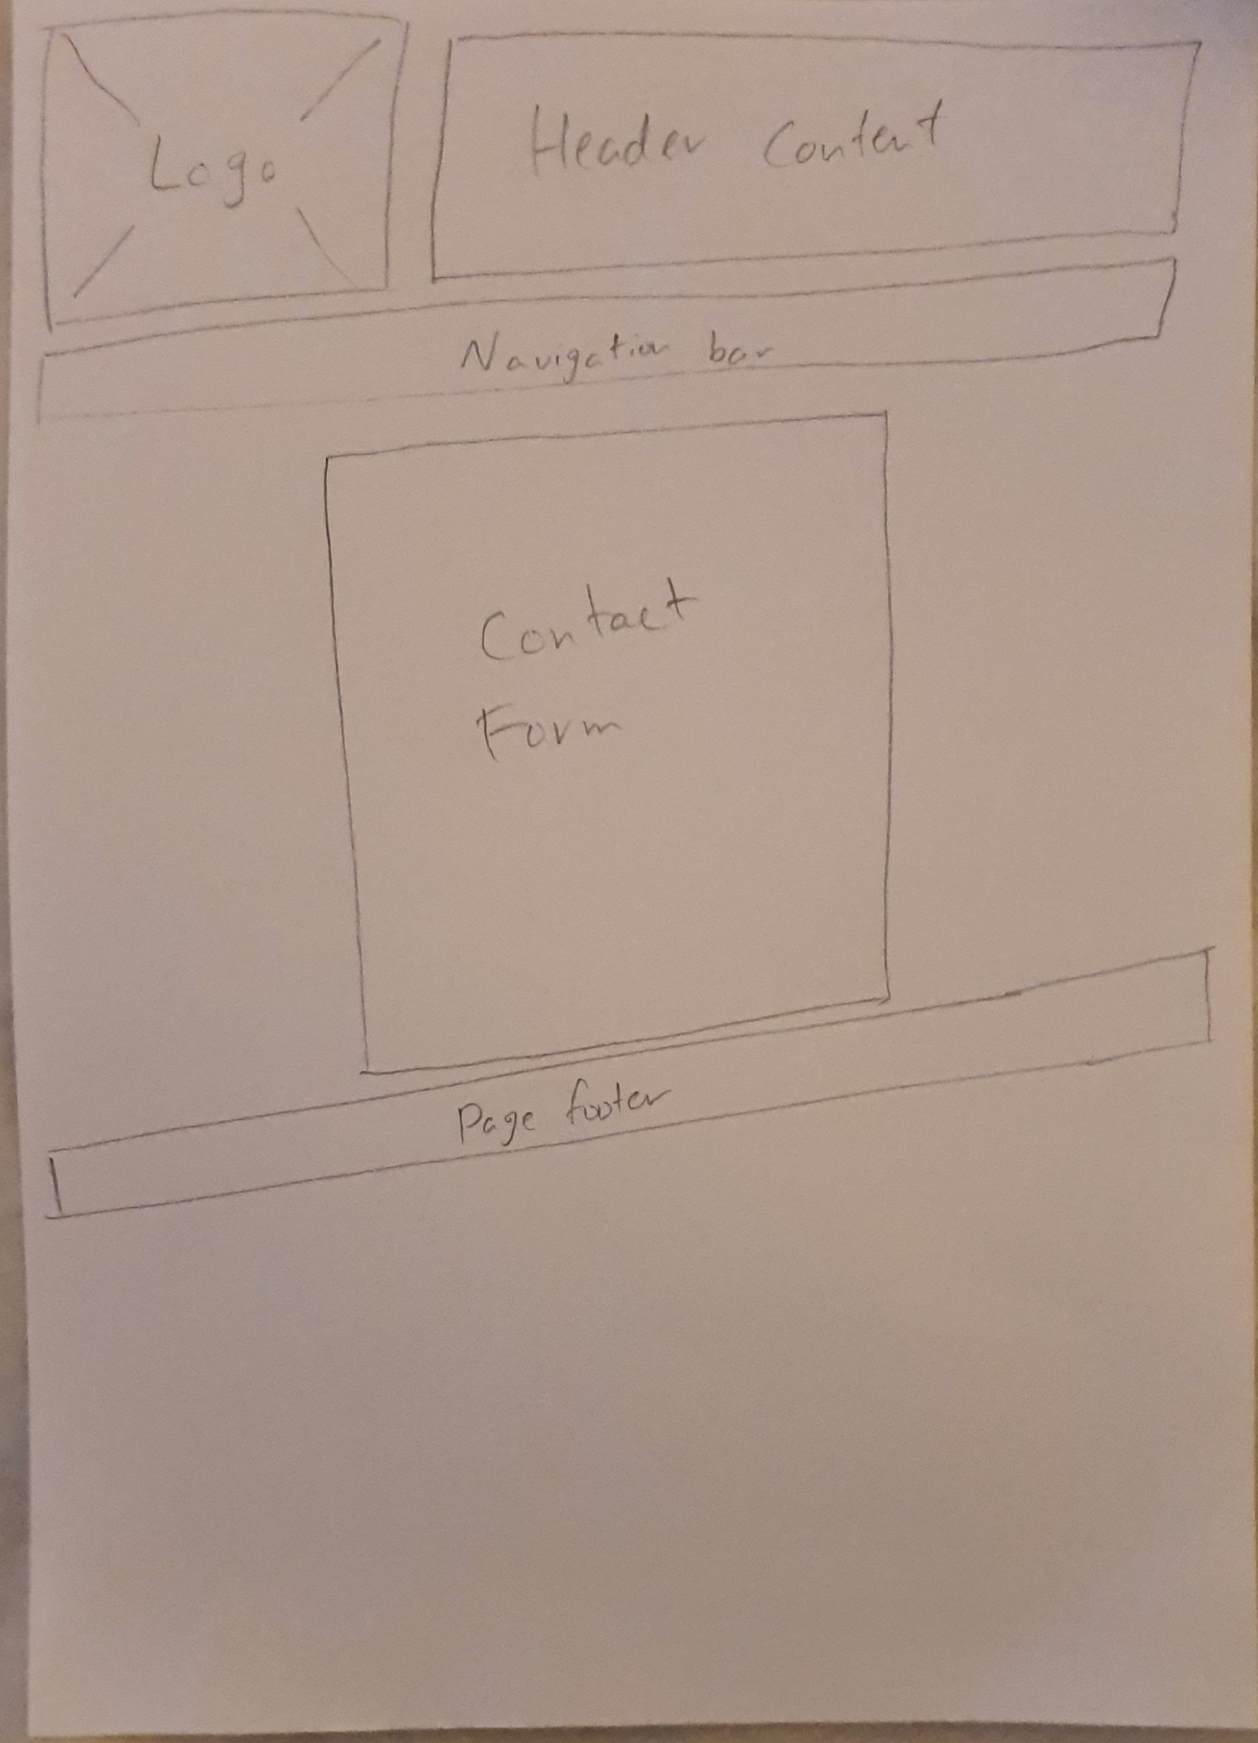
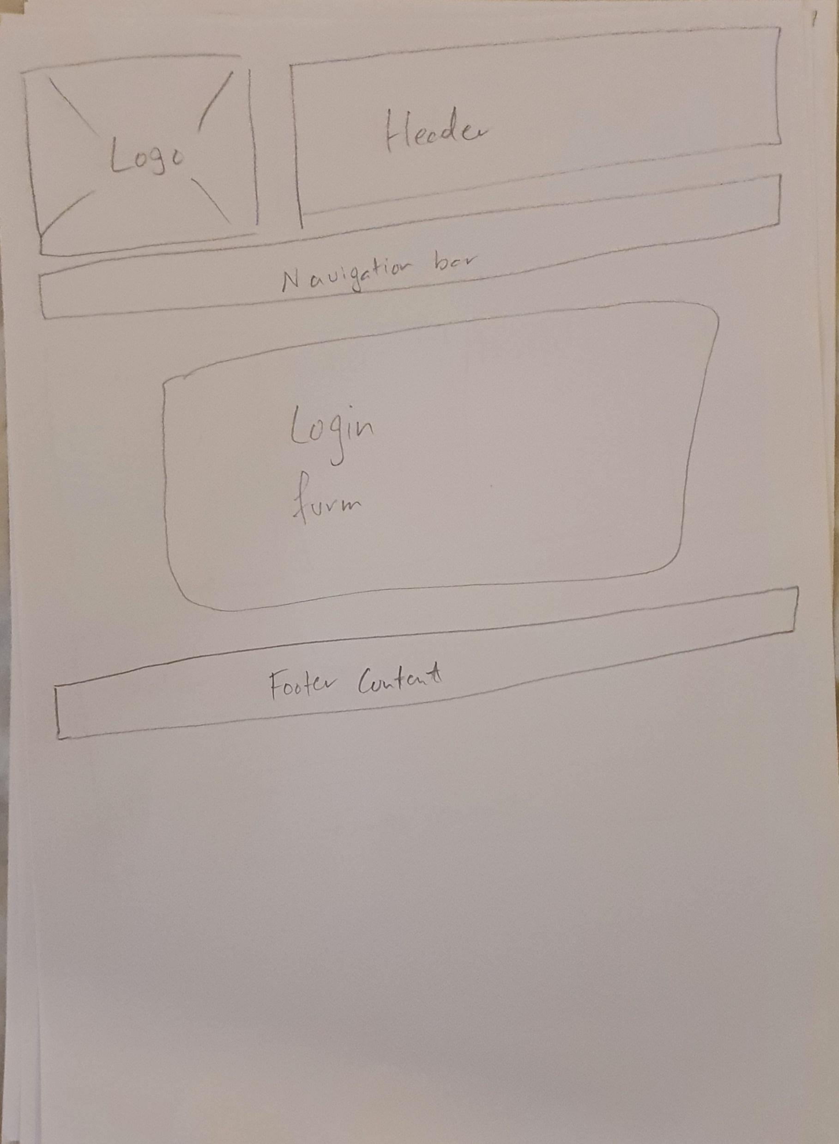


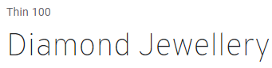
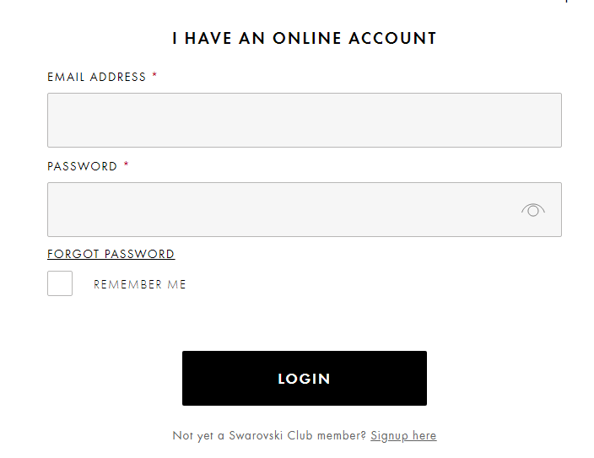
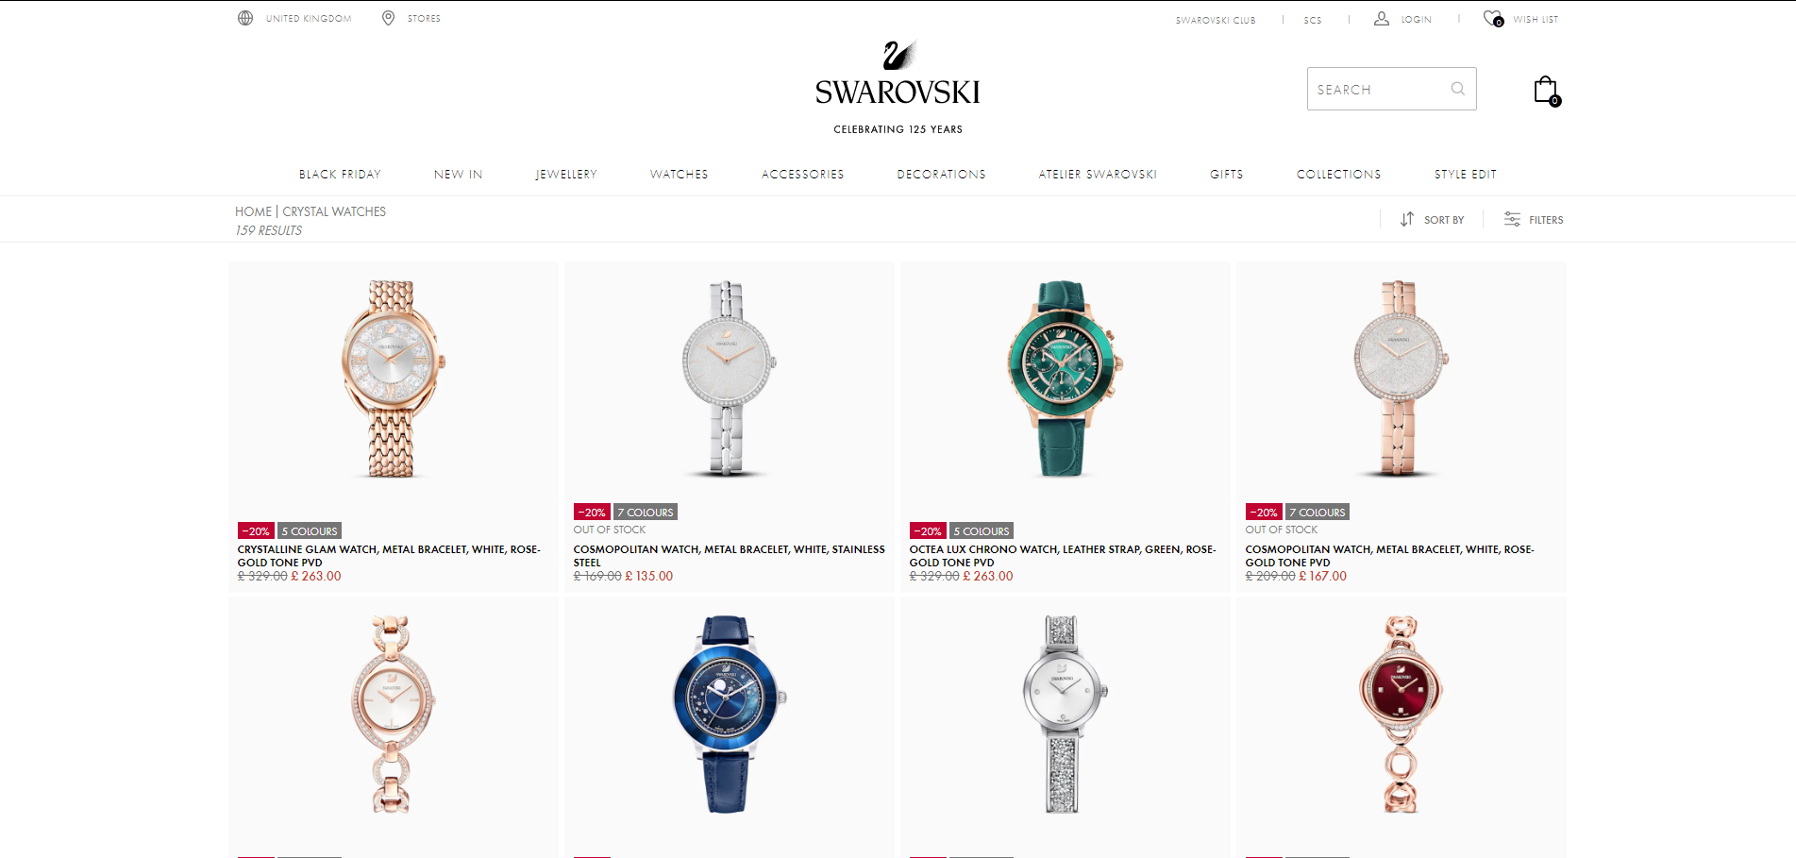
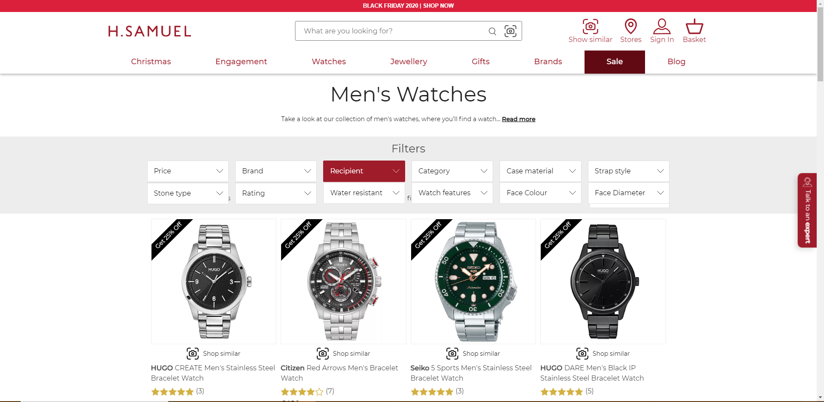
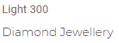
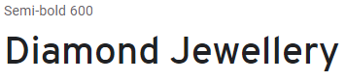
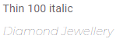


#665946
#EAC28A
#E5C89E
#66615A
#AB9576
#6B0F09
#EE645A
#EB2313
#6B2D29
#B81A0F

Slide 2
Home
Admin login
Products
Members
Contact us
Find us
Watches
Login and register
Contact details form
Google maps image
Company location article
Rings
Login form
Earrings
Register form
Items
products
Order summary
Order summary

Slide 3
Home
Products
Members
Contact us
Find us
Admin login
Admin dashboard
Watches
Login and register
Contact details form
Google maps image
Login form
Admin data
Rings
Login form
Company location article
Customer data
Earrings
Register form
Product data
Items
products
Order summary
Order summary

Slide 4
Home
Home
Watches
Rings
Earrings
login
Members
Contact us
Find us
YouTube video
Items
Items
Items
Login form
products
Contact details form
Google maps image
Watches
Order summary
Order summary
Order summary
Register form
Order summary
Company location article
Rings
Earrings

Slide 5
Admin login
Admin dashboard
Login form
Admin data
Customer data
Product data

Slide 6





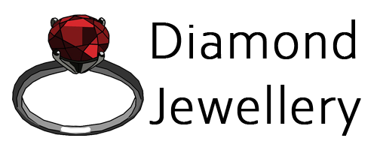
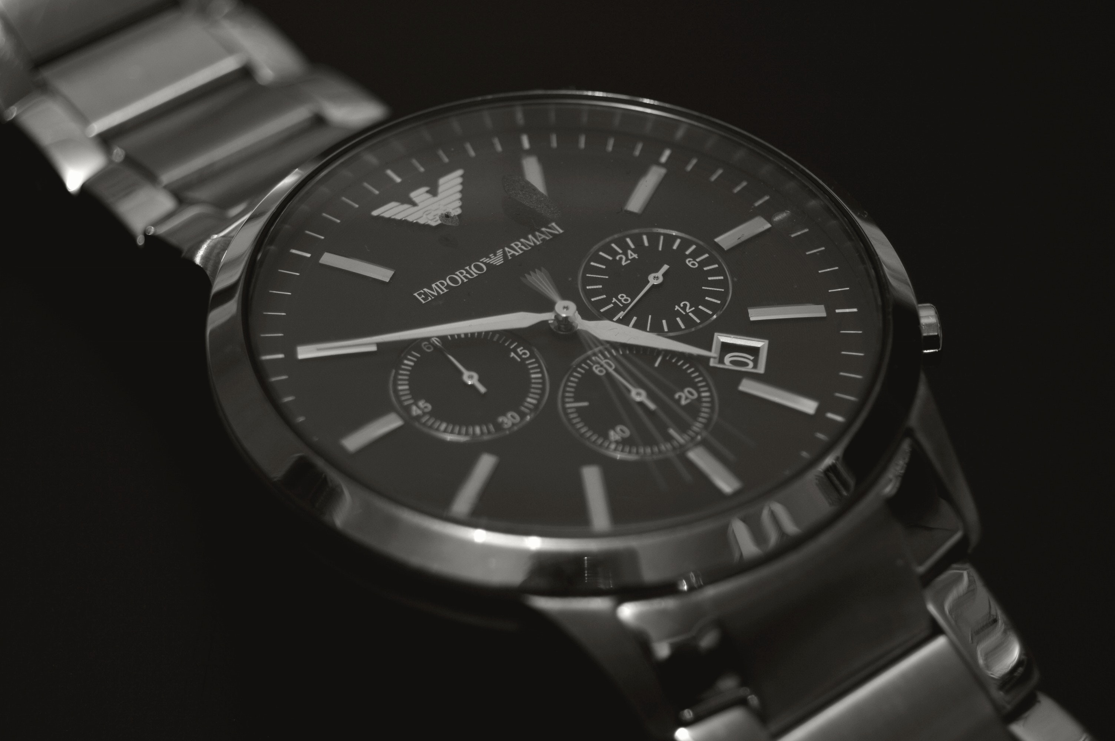
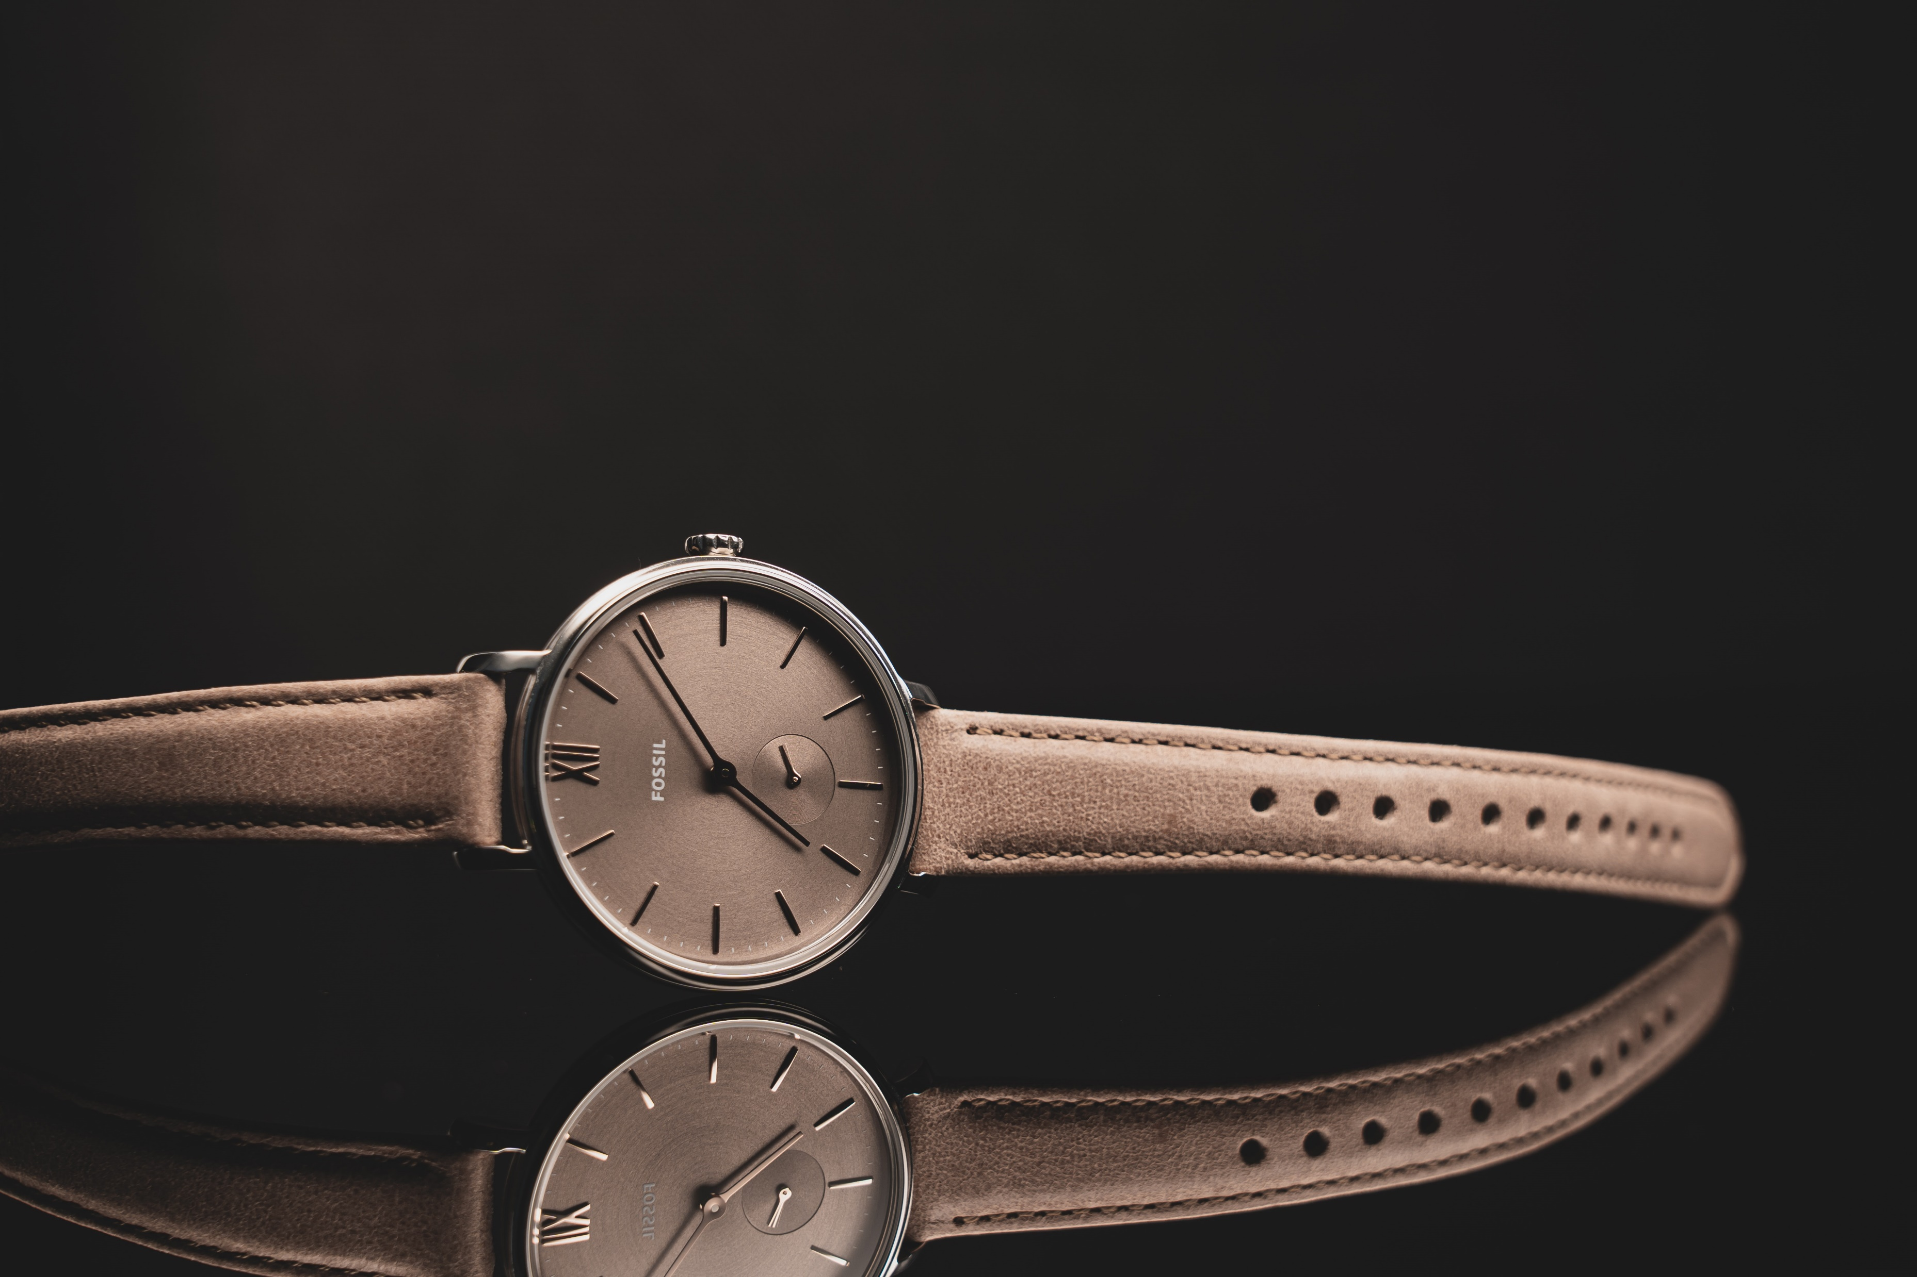
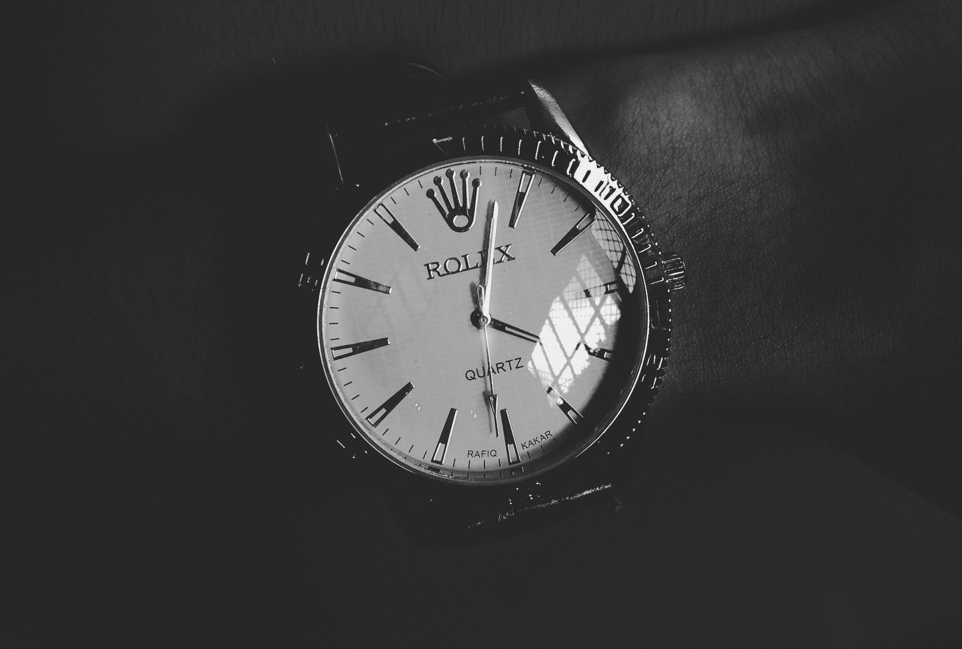




Products
http://www.DiamondJewellery.com
Home
Products
Members
Contact us
About us
Watches
Diamond Jewellery Time Jet black
Jet Black
Bracelet
Stainless Steel
£140
Diamond Jewellery Lux Gold
Gold
Leather strap
£75
Diamond Jewellery Lux Gold
Grey
Leather strap
£65
Diamond Jewellery Lux Gold
Black
Leather strap
£105
Quantity
Quantity
Quantity
Quantity
Diamond Jewellery ©

